Slide 1
Agenda

Slide 2
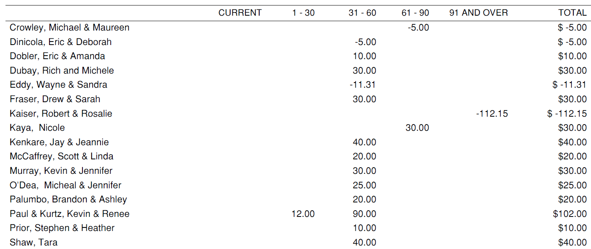
Current State
2017 Account Payable Owed
2017 Account Receivable Owed
TOTAL
$12.00
$305.00
$30.00
$347.00
$11,564.24
$347
Short Term Capital Fund
$52,000 Due in October 2020 at 3% per Annum

Slide 3
Fiscal Year 2018 Proposed Budget – Tennis and Recreation
Notes:
Tennis Only
Admin $23,000
Operations $15,000
TOTAL $55,086

Slide 4
Membership Plan – Tennis and Recreation
2018 Revenue from Memberships Projected: $48,350
New Members: Single/Couple will be at Reduced Rate

Slide 5
Recreation Club Drivers
Survey Results
1/3 vs 2/3 pool vs. tennis support
Required investment / dollars to open lower club
Competition with town pool and dropping family memberships
Board and volunteers need to focus on what we can accomplish
Tennis and social overall operating budget is lower

Slide 6
Copper Valley Club Bylaws Vote
Article II Section I: delete "a swimming pool and clubhouse, and other “
Throughout: change "Pool(s) and Ground(s)" to "Grounds“
VII.9: Re-election of member (correction to reference to section of Bylaws)

Slide 7
Appendix

Slide 8
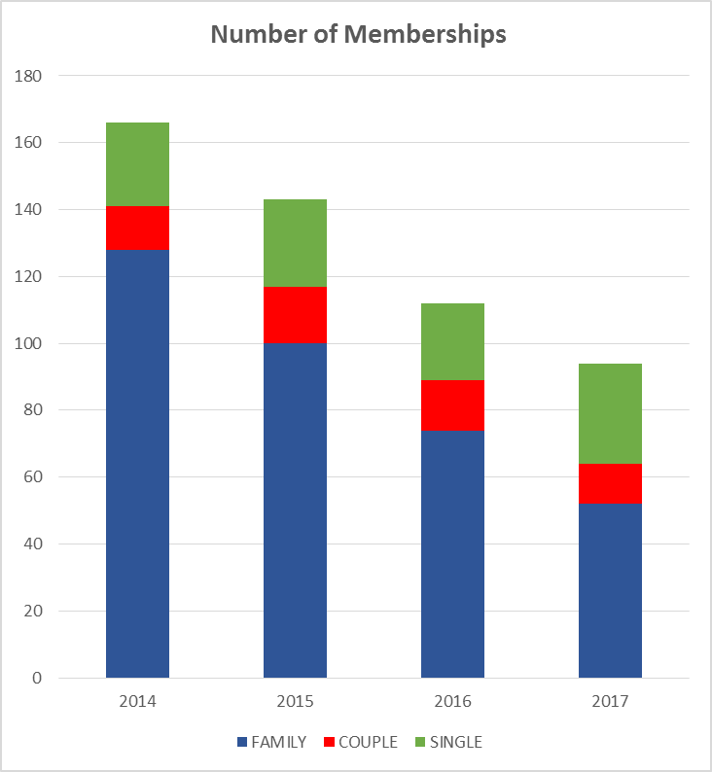
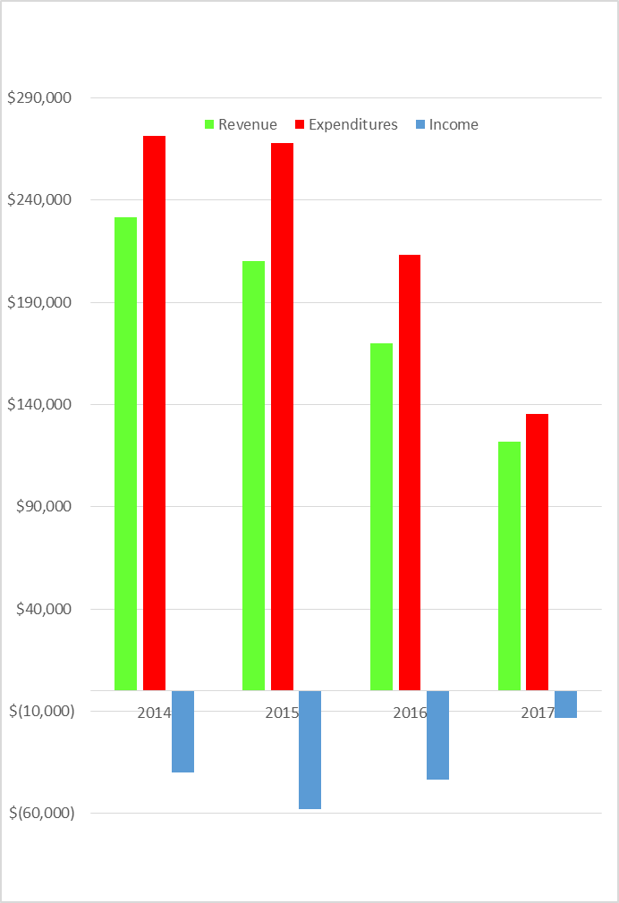
Fiscal Year 2017 Recap
166
143
Biggest Ticket Items
112
94
Family Members have Dropped consistently over 20% per year since 2015
2017 Expenditure Savings $69K from 2016
$13K Shortfall in Income

Slide 9
Fiscal Year Breakdown since 2014
2017 Financial Plan September 16 - Emergency Plan.xlsx
2017 Membership Analysis

Slide 10
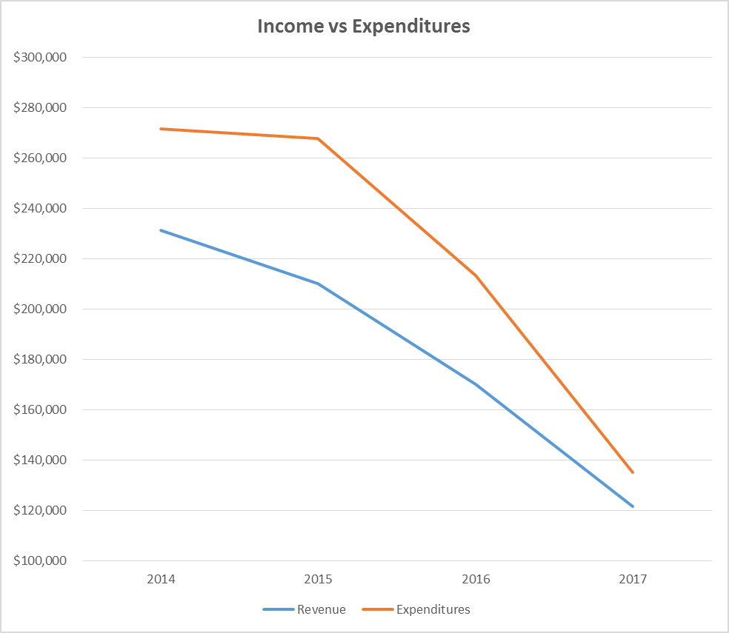
Expenditure Savings $69K from 2016 but still a $13K Shortfall
Family Members have Dropped over 20% since 2015
166
-$40K
Loss
-$58K
Loss
Expenditures
143
-$43K
Loss
112
Revenue
94
-$13K
Loss
Biggest Ticket Items

Slide 11
Fiscal Year 2018 Proposed Budget
Operating: $ 123,423
Capital: $ 96,000
OVERALL: $219,423
2018 Swim Budget
Operating :$67,490
Capital: $91,000
TOTAL : $158,490
2018 Tennis Budget:
Operating: $55,933
Capital: $ 5,000
TOTAL: $60,933
Pool Club Capital
Notes:
Tennis Only
Admin $23,000
Operations $15,000
TOTAL $55,086

Slide 12
Fiscal Year 2018 Swim Budget – Bare Bones Service
2018 Swim Budget
Operating :$42,380
Capital: $45,000
TOTAL : $ 87,380
Note: Bare-Bones Pool Opening: No Life Guard and Dive Pool
Only Fix Deck
Notes:
Tennis Only
Admin $23,000
Operations $15,000
TOTAL $55,086

