Slide 1
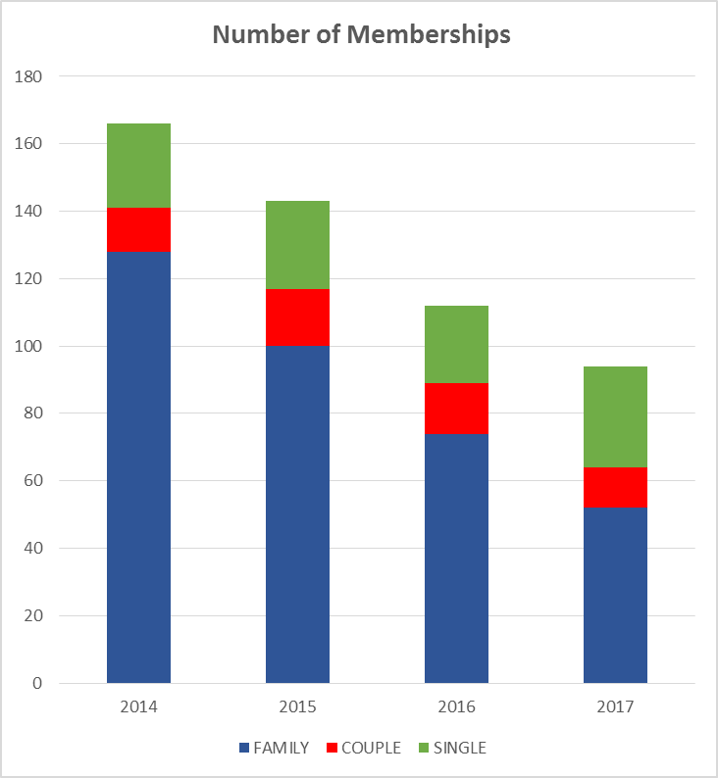
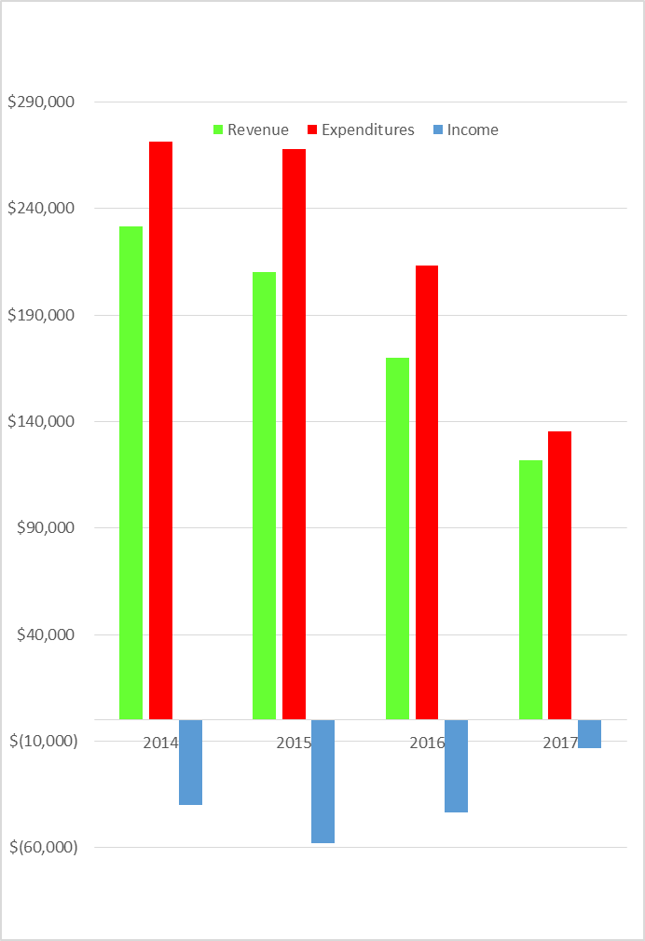
Fiscal Year 2017 Recap
166
143
Biggest Ticket Items
112
94
Family Members have Dropped consistently over 20% per year since 2015
2017 Expenditure Savings $69K from 2016
$13K Shortfall in Income

Slide 2
Fiscal Year 2018 Proposed Budget
Operating: $116,559
Capital: $47,000
OVERALL: $163,559
2018 Swim Budget
Operating :$67,490
Capital: $42,000
TOTAL : $109,490
2018 Tennis Budget:
Operating: $49,069
Capital: $ 5,000
TOTAL: $54,069
Notes:
Tennis Only
Admin $23,000
Operations $15,000
TOTAL $55,086

Slide 3
Next Steps
Short Term
Opening of Club
Need to meet Normal Expenses plus Capital Improvements to Legally Open Pool
Reduced Rate Plan
Payment Plan – Need at least 33% of revenue by January 1st
Sponsorship Plans
Target Large Companies in Area
Partnership Plans
Other Recreational Clubs and Organizations
Management Companies
Long Term
Reduction of Assets for Financial Gain
Over 19 Acres owned with 70% not currently Used

Slide 4
Backup Slides

Slide 5
Fiscal Year Breakdown
2017 Financial Plan September 16 - Emergency Plan.xlsx
Balance to be Paid for FY 2017

Slide 6
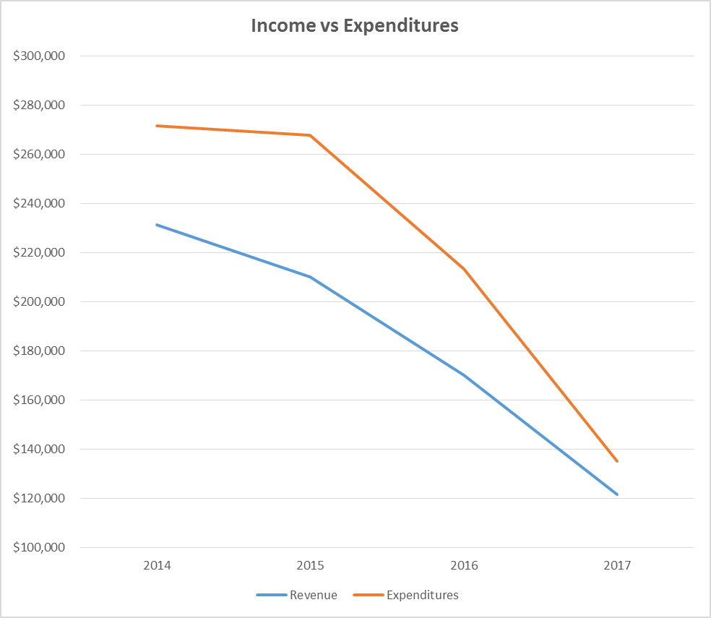
Expenditure Savings $69K from 2016 but still a $13K Shortfall
Family Members have Dropped over 20% since 2015
166
-$40K
Loss
-$58K
Loss
Expenditures
143
-$43K
Loss
112
Revenue
94
-$13K
Loss
Biggest Ticket Items

Slide 7
2018 Tennis ONLY
2018 Tennis Budget:
Operating: $17,086
Admin: $23,000
Operations $15,000
Capital: $ 5,000
TOTAL: $60,086
Note: Admin Largest Cost Taxes @$16.4K
Notes:
Tennis Only
Admin $23,000
Operations $15,000
TOTAL $55,086

